Slide 1


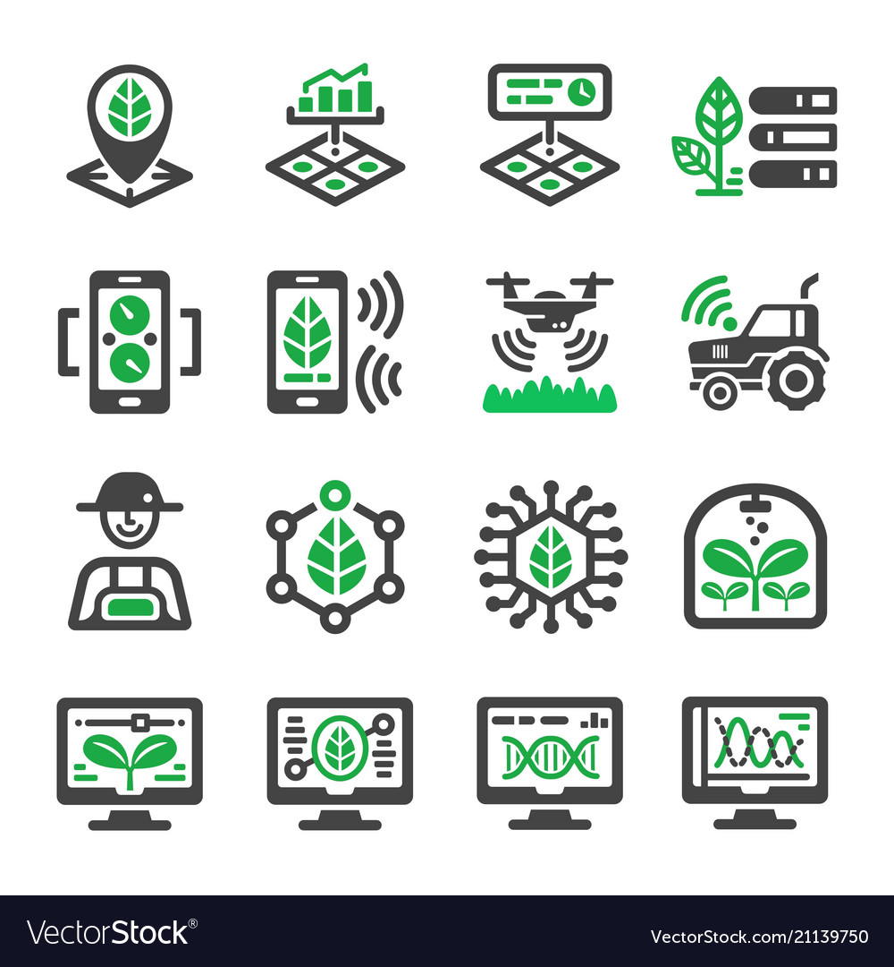
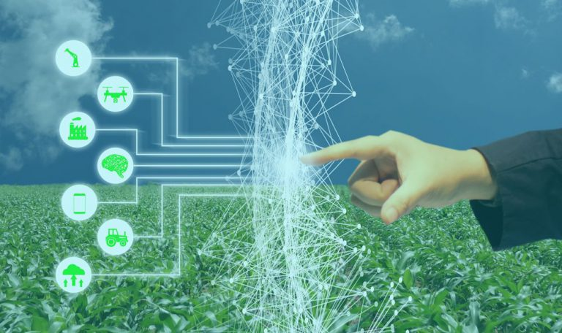

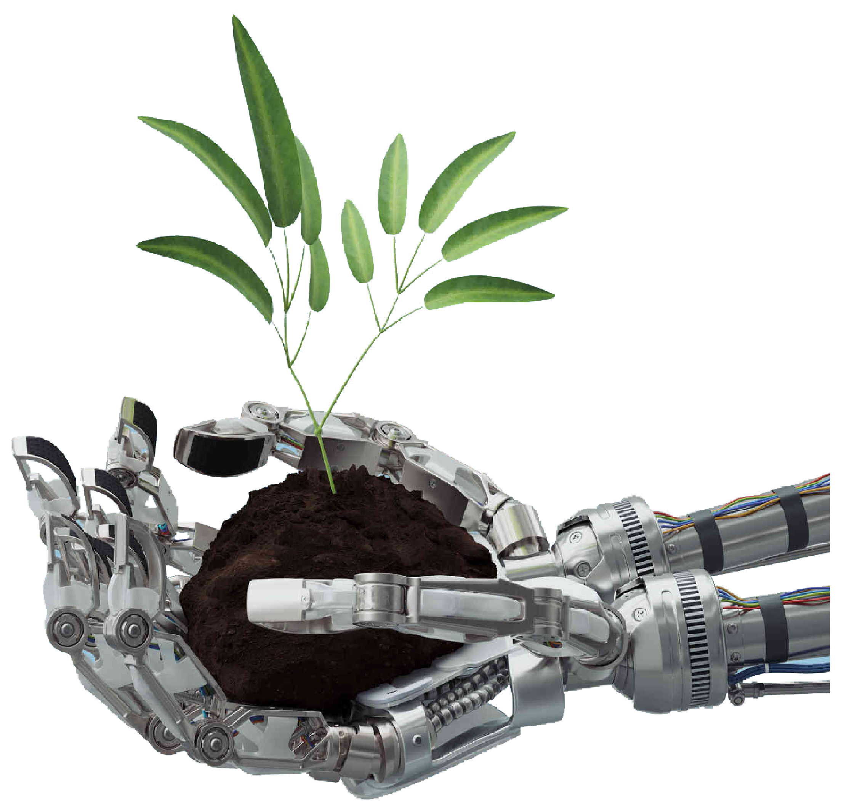
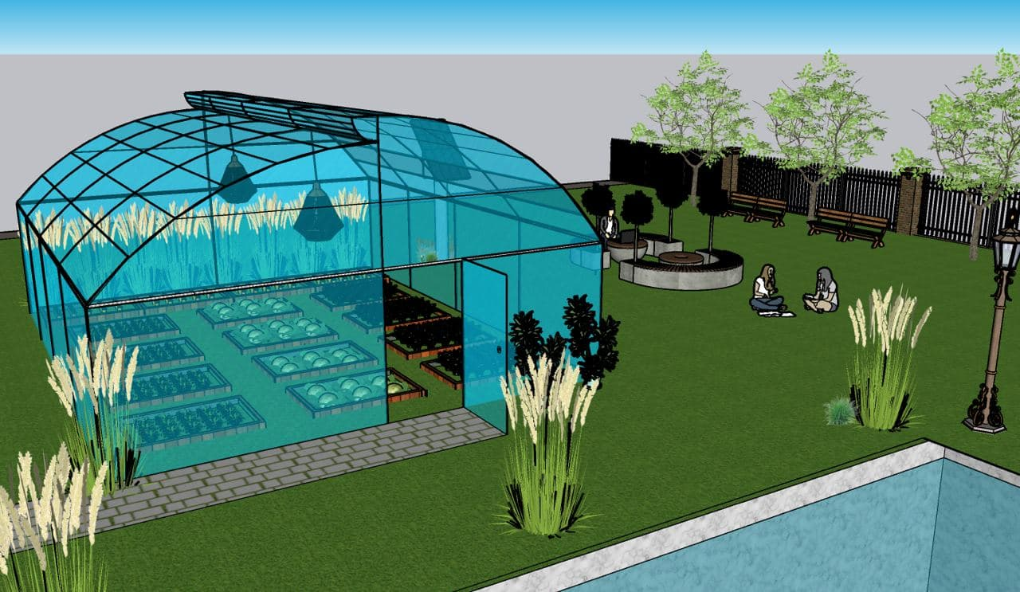
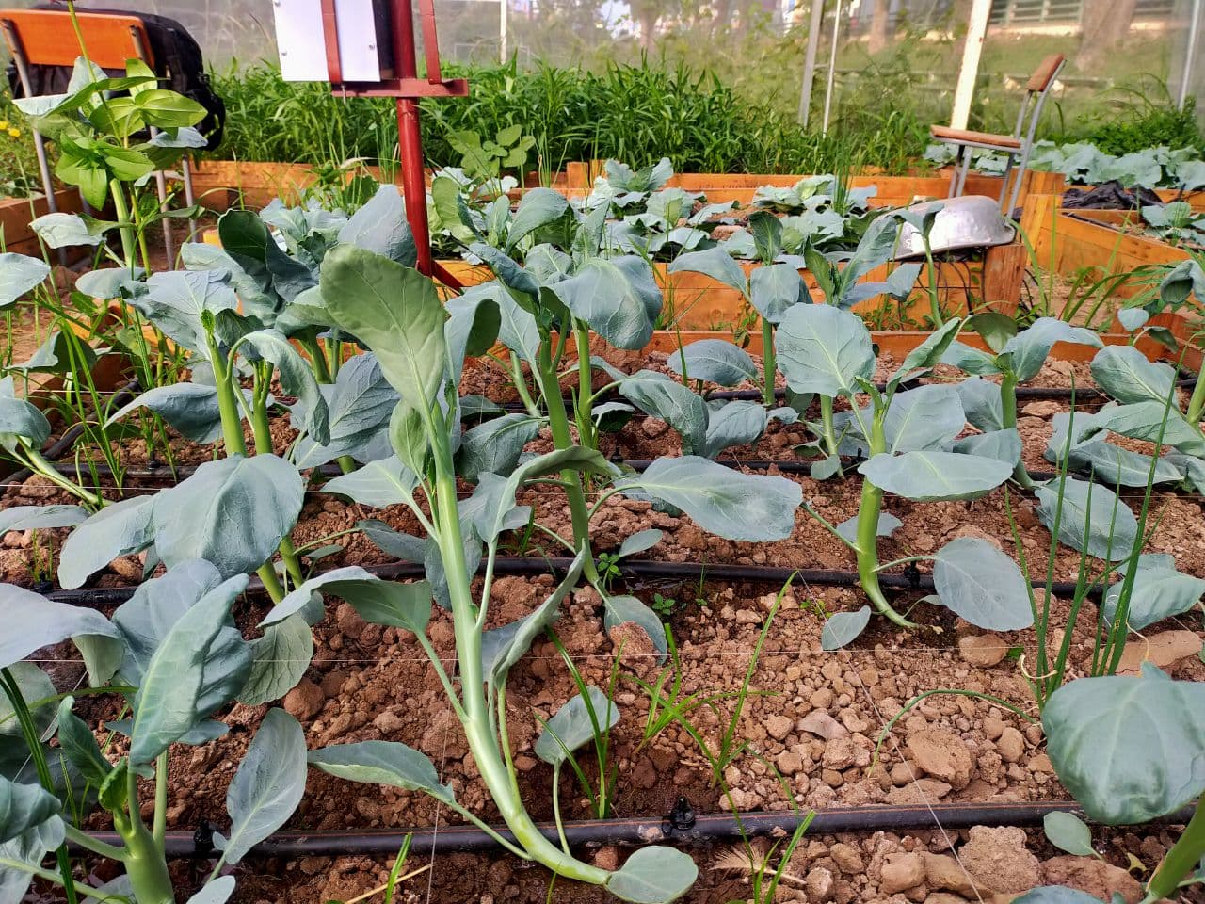
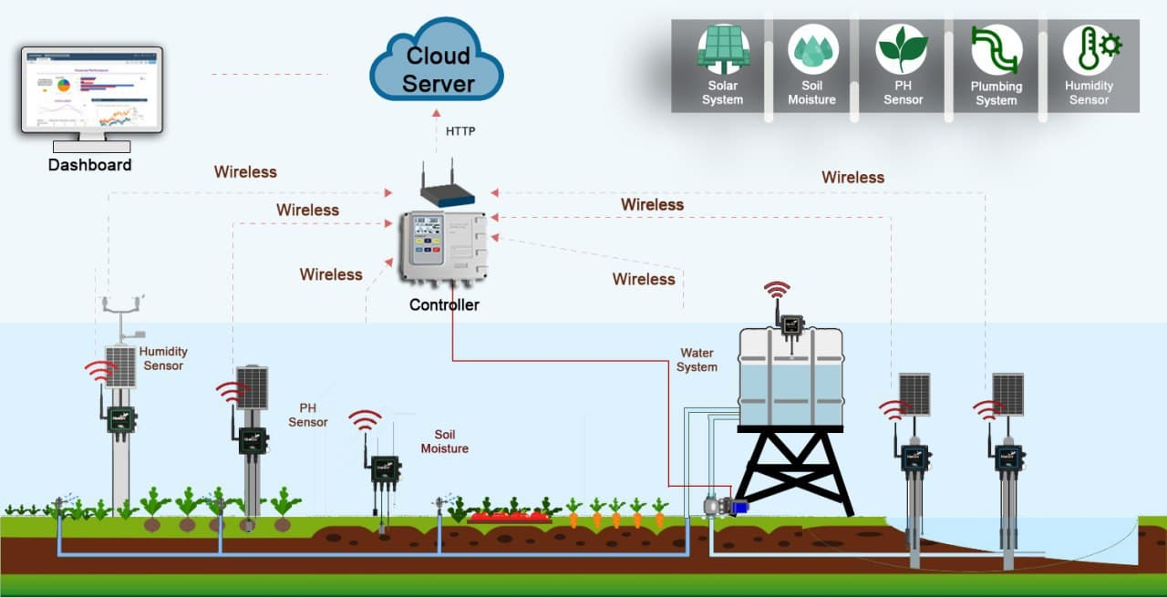
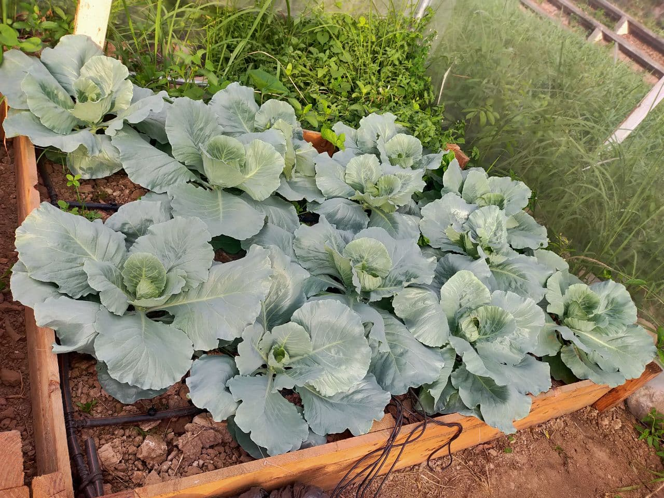
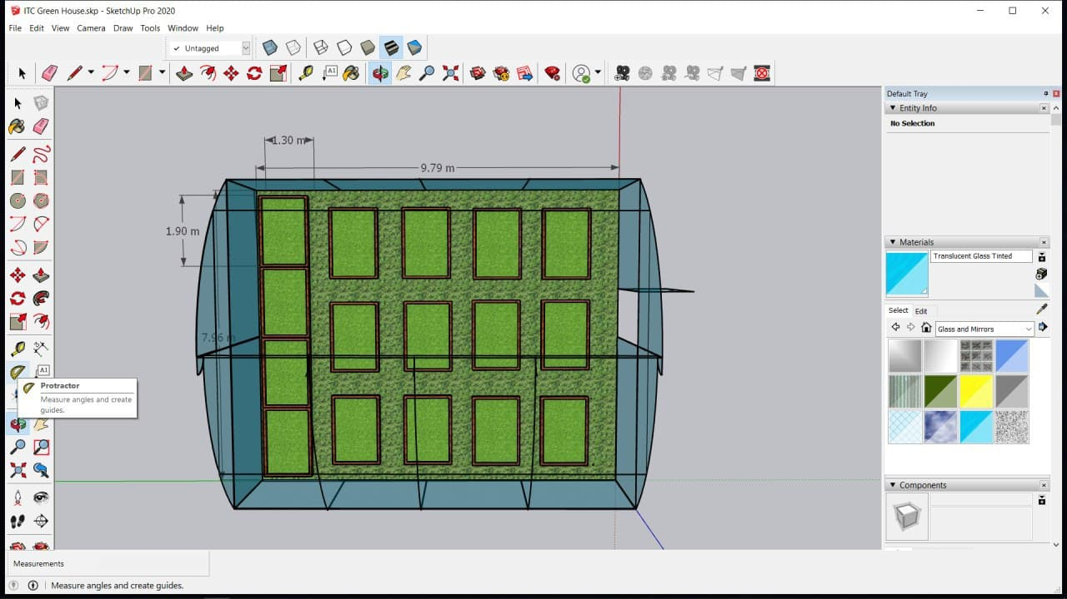
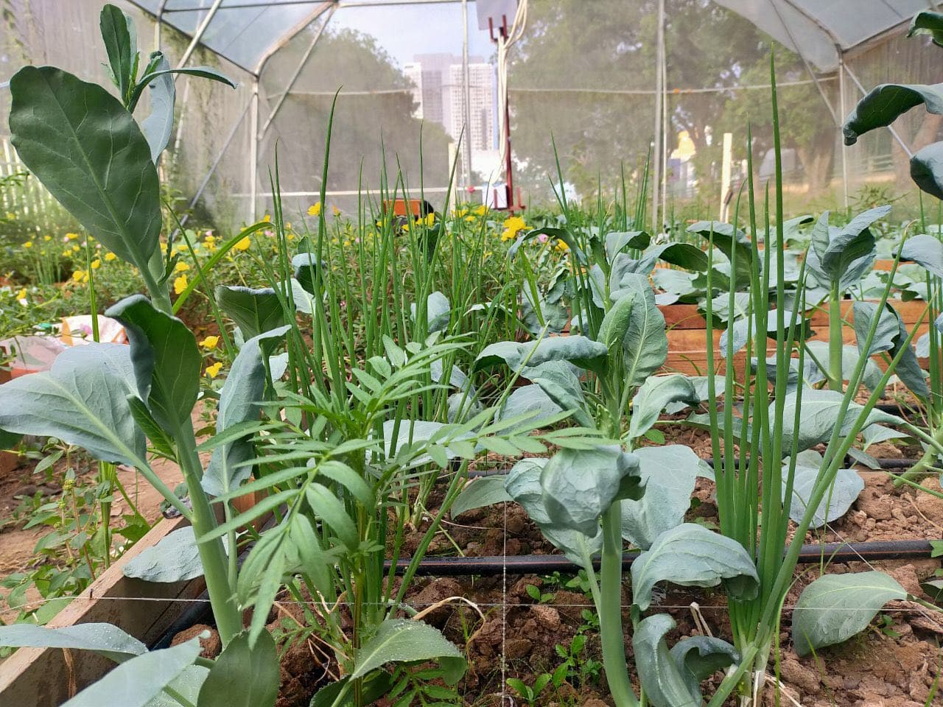
IOT PLATFORMS FOR SMART IRRIGATIONS
“AI FOR AGRICULTURE”
ADVISOR : HEL CHANTHAN
STUDENT : CHEK NITA
INTRODUCTION
AI
PROCESSING
Agriculture and farming is one of the oldest and most important professions in the world. Humanity has come a long way over the millennia in how we farm and frow crops with the introduction of various technologies. As the world population continues to grow and land become more scarce, people have needed to get creative and become more efficient about how we farm, using less land to produce more crops and increasing the productivity and yield of those farmed acres.
So we decided to create an AI to apply and estimate data analytic for agriculture applications .
The use of Artificial intelligence in agriculture helps the farmers to understand the data insights such as temperature, precipitation, wind speed, and solar radiation. The data analysis of historic values, offers a better comparison of the desired outcomes with the data that has been collected from the actual farm.
- Collect Data from Clouds, and all data are in photographs
- Clean and Prepare data and collect only study area
Use the filtration data and apply machine learning techniques to make an analysis
Train Data and Test Data
Make Prediction and improve the systems
SMART FARM
DATA COLLECTION
RESULTS
As we mentioned above, This project focus on how to develop the IOT platform to apply for agriculture for smart farming .
b. Smart Farm
By applying the AI into the agriculture applications we get :
- Convenience to control the data
- Emphasis on checking defective crops and improving the potential for healthy crop production
- Have the potential to solve the challenges farmers face such as climate variation, an infestation of pests and weeds that reduces yields
The best part of implementing AI in agriculture that it won’t eliminate the jobs of human farmers rather it will improve their processes.
Plant (a)
We will use photo analysis to collect information from the actual plants and predict the yields of the crop and its production.
Plant (b)
a. Smart Farming System
Plant (c)
c. Smart Farm

